Slide 1
Deep Neural Network For Simple Images From Scratch
Sam Pease

Slide 2
Original Project Description
Goals:
Write a Neural Network from scratch to fully understand their intricacies
Make it modular in a way to be able to compare performance while tweaking parameters such as network topology, activation function, learning rate, loss function
Data: I intended to use a dog breed dataset I found to test image recognition

Slide 3
Project Changes
Immediately realized a CNN was needed for the dog breed dataset - 10,000 high-res photos of 120 breeds (1)
Decided to try image classification on low-res images using a DNN
Found a cat identification dataset - 209 64x64 images (2)
Decided I had too few datapoints at the model quickly overfit training data while still underperforming on test data
Tried using Cifar10 dataset of 60000 32x32 color images in 10 classes (3)
Still had low performance despite large amounts of relatively low dimensional data. Found others with the same problem (4)
Reduced Cifar10 dataset to 12000 images with binary classification of Cat or Not Cat

Slide 4
Other Works
In my original Cat Dataset, the article I found was able to reach 72% accuracy on test data with a simple 2-layer topology and 7 hidden nodes in the hidden layer.
I was not able to improve on these numbers using a larger network so turned to finding a larger dataset
Using the Cifar10 dataset the article I found reached 55% accuracy in classifying 10 images using a deep neural network using a 1536-768-384-128 topology network, relu activation function, and 0.001 learning rate
I was only hitting accuracies in the 30-40% range and realized the limitation of DNN in image classification so decided to simplify the problem to binary classification and see what could be done

Slide 5
My Implementation
Input:
Data: 3072 dimensional from flattening a 32x32x3 color images. Fed in in a 3072xM matrix where M is number of datapoints
Labels: 1xM matrix with entries 1 meaning the corresponding data input is a cat and 0 otherwise
Layers dimensions: a list of numbers describing the number of nodes on each layer
Activation function: sigmoid, relu, arctan, or softplus (others can be easily implemented)
Learning rate
First separates data into training and validation cuts at a 90-10 ratio
Weights and Biases are initialized as matrices with dimensions determined by layer dimensions. Weights are normally distributed and scaled by input dimension. Biases are initialized to zero.

Slide 6
My Implementation
Next the data is repeatedly
forward propagated using the input activation function and current weights and biases. An exception is the final layer is always a sigmoid function
Back propagated to determine the gradients in matrix form
Weights and biases are updated by subtracting inputted learning rate*calculated gradient
Every 100 iterations of the above, the accuracy is determined by forward propagating the validation set.
A max accuracy achieved is recorded and if 1000 iterations have passed without the max accuracy improving then the network stops training
The weights and biases corresponding to the maximum accuracy achieved are then returned

Slide 7
Results
Activation Function | Topology | Learning Rate | Final Accuracy | Iterations Taken
relu | 3072-100-1 | 0.1 | 0.722 | 2400
relu | 3072-100-1 | 0.01 | 0.709 | 2800
relu | 3072-768-384-128-1 | 0.01 | 0.694 | 700
sigmoid | 3072-100-1 | 0.1 | 0.689 | 2100
relu | 3072-100-1 | 0.001 | 0.689 | 9400
softmax | 3072-100-1 | 0.01 | 0.688 | 2900
arctan | 3072-100-1 | 0.01 | 0.686 | 1300
sigmoid | 3072-100-1 | 0.01 | 0.683 | 7400
sigmoid | 3072-1 | 0.01 | 0.672 | 2800
sigmoid | 3072-10-1 | 0.01 | 0.669 | 5300
sigmoid | 3072-100-1 | 0.001 | 0.625 | 9200
sigmoid | 3072-768-384-128-1 | 0.01 | 0.592 | 1200

Slide 8
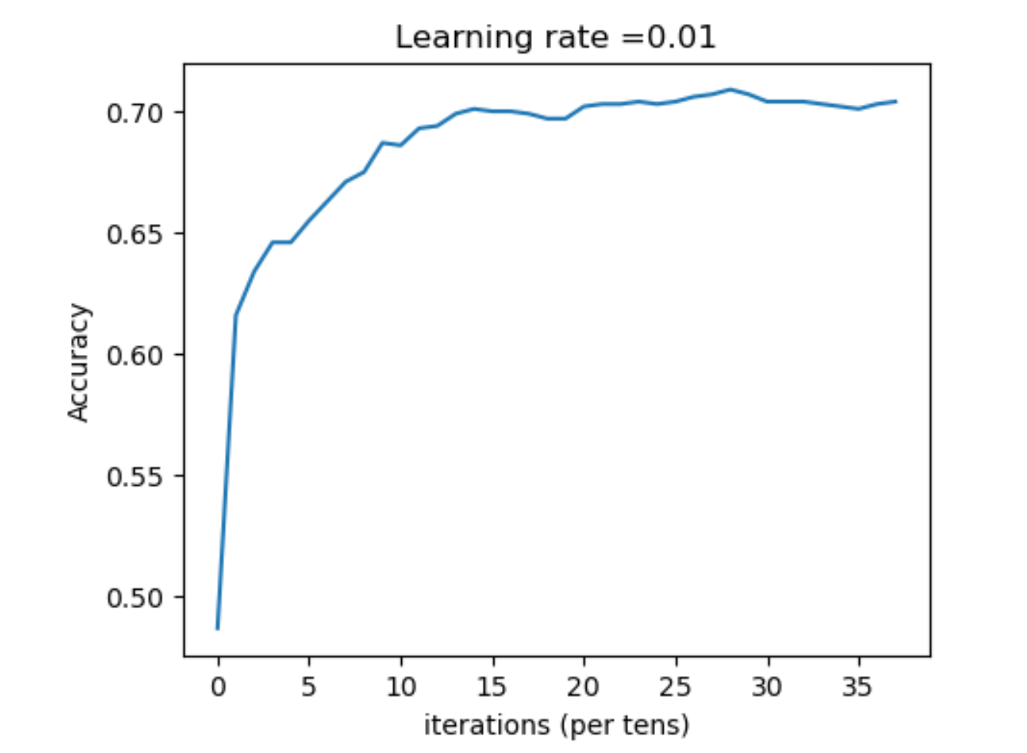
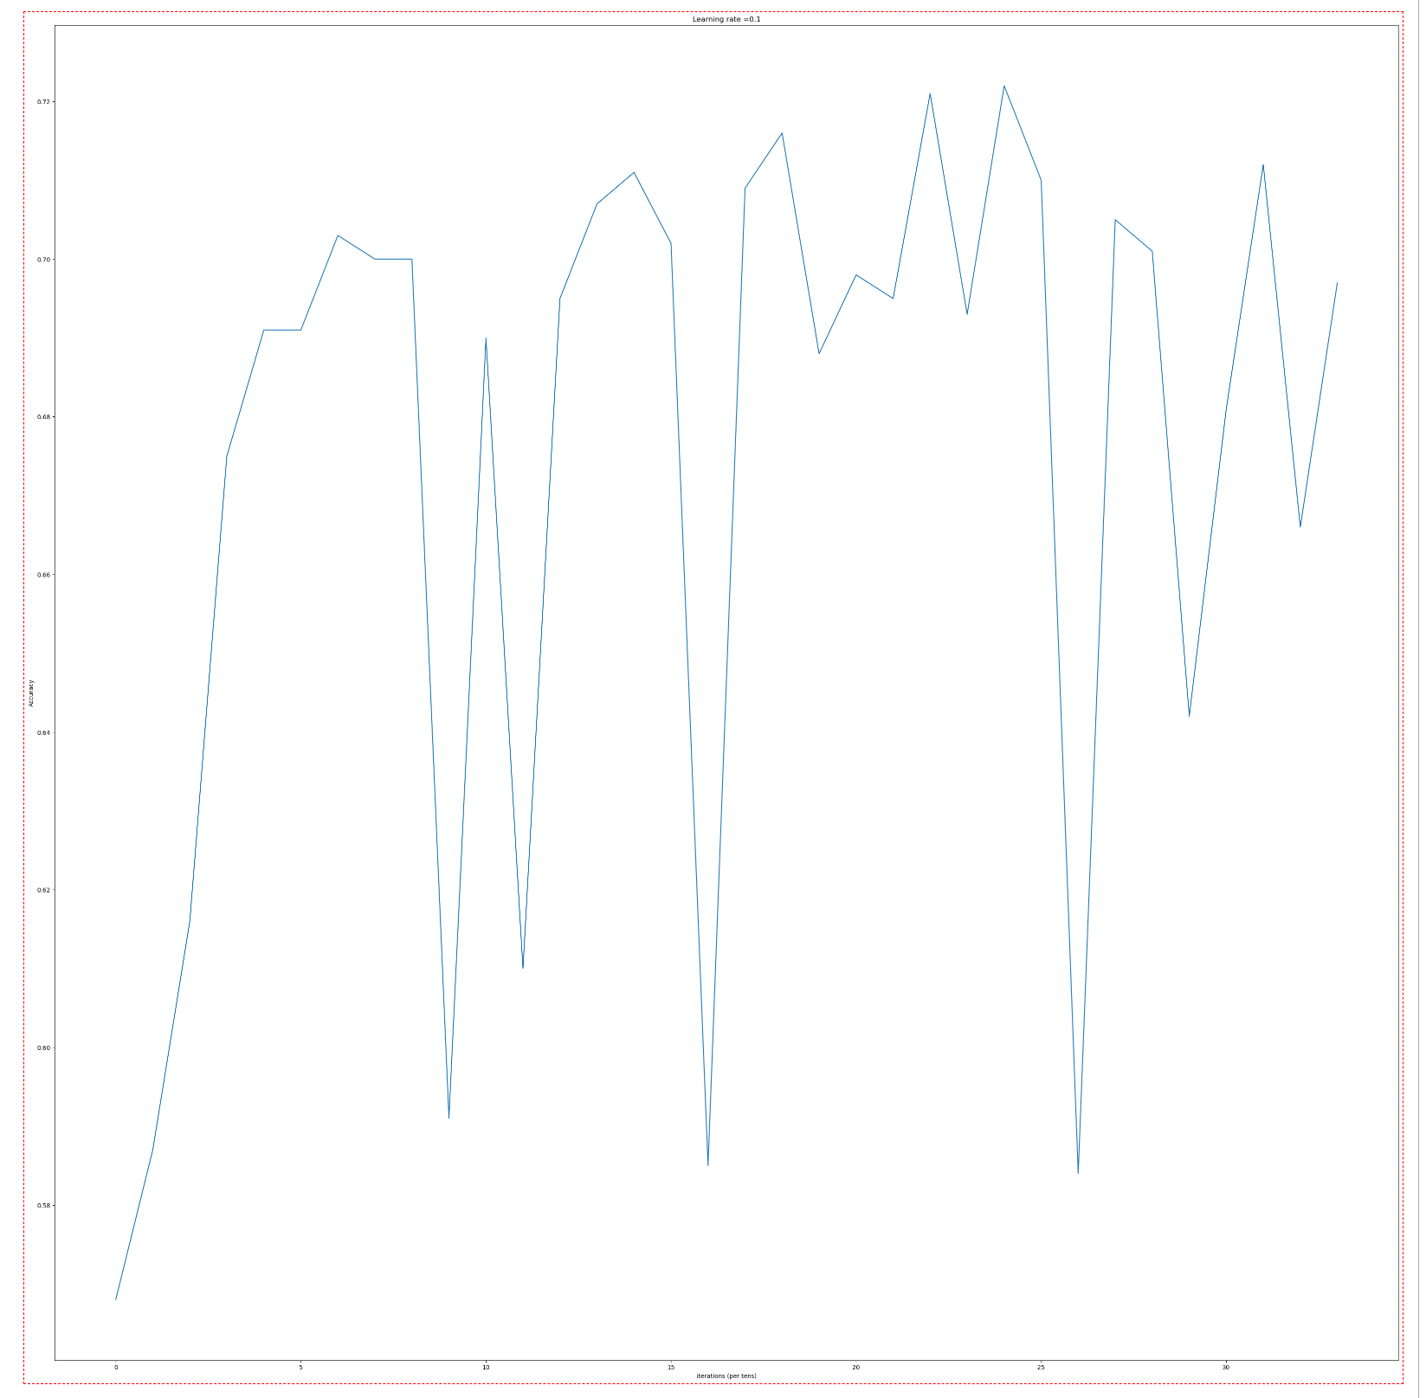
Results
Activation function
Learning Rate
Activation Function | Topology | Learning Rate | Final Accuracy | Iterations Taken
relu | 3072-100-1 | 0.01 | 0.709 | 2800
softmax | 3072-100-1 | 0.01 | 0.688 | 2900
arctan | 3072-100-1 | 0.01 | 0.686 | 1300
sigmoid | 3072-100-1 | 0.01 | 0.683 | 7400
Activation Function | Topology | Learning Rate | Final Accuracy | Iterations Taken
sigmoid | 3072-100-1 | 0.1 | 0.689 | 2100
sigmoid | 3072-100-1 | 0.01 | 0.683 | 7400
sigmoid | 3072-100-1 | 0.001 | 0.625 | 9200
relu | 3072-100-1 | 0.01 | 0.709 | 2800
relu | 3072-100-1 | 0.001 | 0.689 | 9400
Topology
Activation Function | Topology | Learning Rate | Final Accuracy | Iterations Taken
sigmoid | 3072-100-1 | 0.01 | 0.683 | 7400
sigmoid | 3072-1 | 0.01 | 0.672 | 2800
sigmoid | 3072-10-1 | 0.01 | 0.669 | 5300
sigmoid | 3072-768-384-128-1 | 0.01 | 0.592 | 1200
Accuracy of Best performing Models while training:
relu | 3072-100-1 | 0.01 | 0.709 | 2800
relu | 3072-768-384-128-1 | 0.01 | 0.694 | 700

Slide 9
Limitations
Perhaps the largest limitation is the attempt to use a deep neural network for image classification. I initially thought a large enough network and small enough image would over come this. If anything, my project points to the opposite
Processing Power
I ran all training loops on my personal laptop cpu and that slowed down the project and limited my ability to test different parameters
Moving forward one could optimize to run on a gpu or use some cloud computing resources

Slide 10
Limitations Continued
When looking for reason for my model’s underperformance I found a medical study that neural networks in fact preformed significantly better on higher resolution images (5)
So the fact that the cifar10 dataset is 32x32 images may have been a detriment rather than an aid to model performance
Anecdotally I find the 32x32 images difficult to recognize so this is not surprising

Slide 11
Conclusion
I drastically overestimated deep neural networks ability to solve everything
I was surprised to see increasing network topology complexity did not necessarily improve accuracy
Learned fundamental feature of a model cannot be overcome by correctly tweaking parameters

Slide 12
Sources
https://www.kaggle.com/competitions/dog-breed-identification/data
https://towardsdatascience.com/step-by-step-guide-to-building-your-own-neural-network-from-scratch-df64b1c5ab6e
https://www.cs.toronto.edu/~kriz/cifar.html
https://towardsdatascience.com/implementing-a-deep-neural-network-for-the-cifar-10-dataset-c6eb493008a5
https://pubs.rsna.org/doi/full/10.1148/ryai.2019190015

